Slide 1


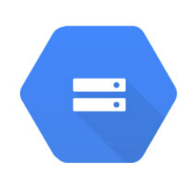

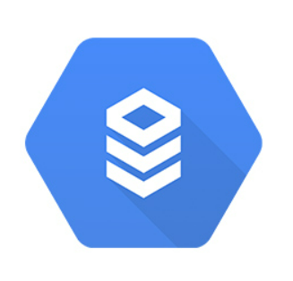

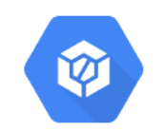










High Level Solution Architecture
Customer Table Policy Table Agent Table
External Data Table
Pipeline Orchestration and Automation
Cloud Storage
Cloud Source Repository
Models & pipelines
Cloud Build
Params & metrics
Cloud SQL
Cloud SQL
Cloud Run
Container Registry
Batch Prediction (For list of policies)
Explainable AI
End User
HTTP URL
Online Prediction (For single customer)

